Slide 1
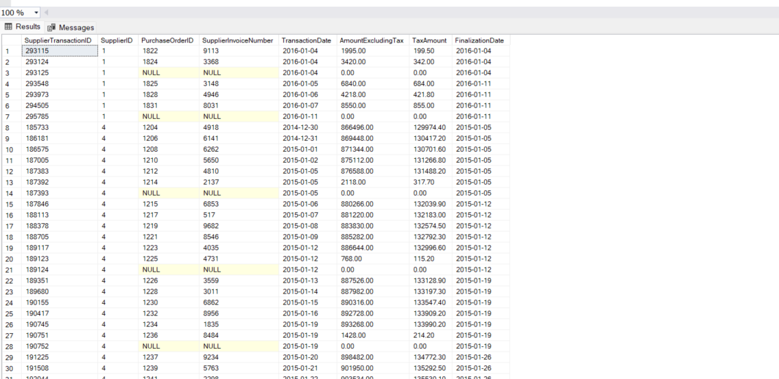

Slide 2
SELECT Fields you want in the query results
FROM table
WHERE filter data
ORDER BY sort data

Slide 3
SELECT SupplierTransactionID, SupplierID, PurchaseOrderID, SupplierInvoiceNumber, TransactionDate, AmountExcludingTax, TaxAmount, FinalizationDate
FROM Purchasing.SupplierTransactions

Slide 4
SELECT SupplierTransactionID, SupplierID, PurchaseOrderID, SupplierInvoiceNumber, TransactionDate, AmountExcludingTax, TaxAmount, FinalizationDate
FROM Purchasing.SupplierTransactions
WHERE FinalizationDate > '2014-12-31’

Slide 5
SELECT SupplierTransactionID, SupplierID, PurchaseOrderID, SupplierInvoiceNumber, TransactionDate, AmountExcludingTax, TaxAmount, FinalizationDate
FROM Purchasing.SupplierTransactions
WHERE FinalizationDate > '2014-12-31’
ORDER BY SupplierID, FinalizationDate

